Slide 1


MULTITOUCH POLYGON MORPHING

Slide 2
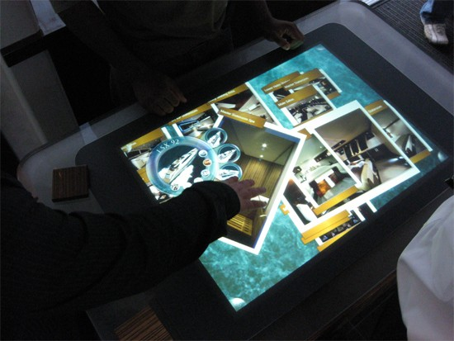
INTRODUCTION

Slide 3

HARDWARE AND SOFTWARE REQUIREMENTS
CPU -2GHZ
RAM- 2GB
HARD DISK-40GB
JAVA 1.6

Slide 4
HARDWARE DESIGN

Slide 5
SOFTWARE DESIGN

Slide 6
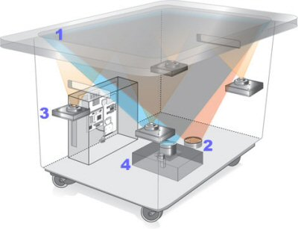
WORKING

Slide 7
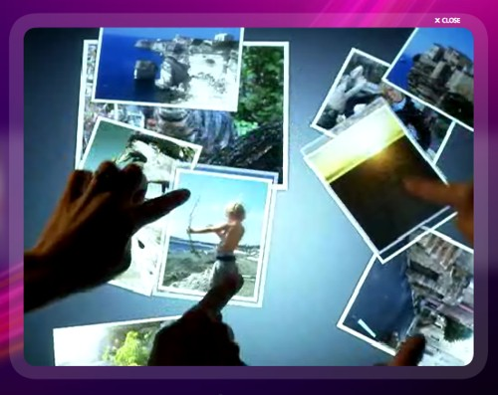
APPLICATIONS

Slide 8
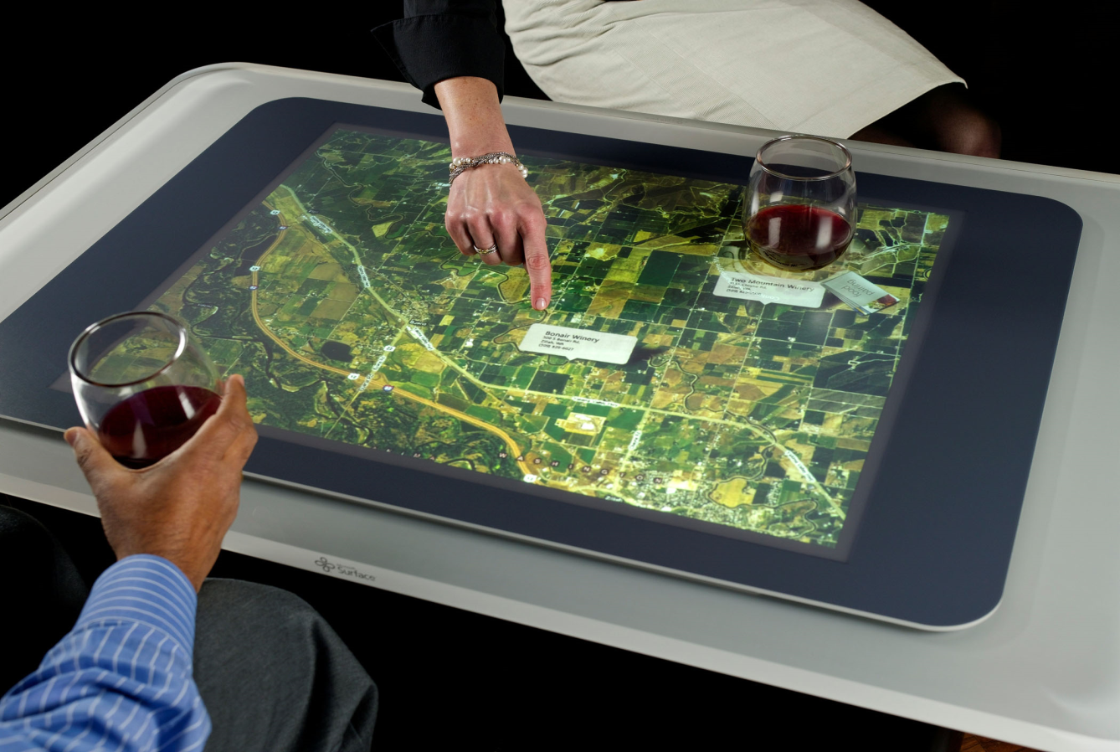
CONCLUSION

Slide 9
THANK YOU

